Slide 1
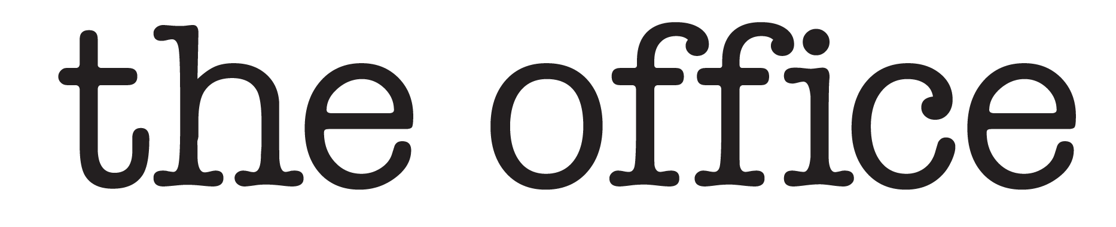
Team leader: Roberto Di Biase,
Christopher Daldalian, Dmitrii Kudrik, Anita Mirshahi
& Valini Rangasamy

Slide 2
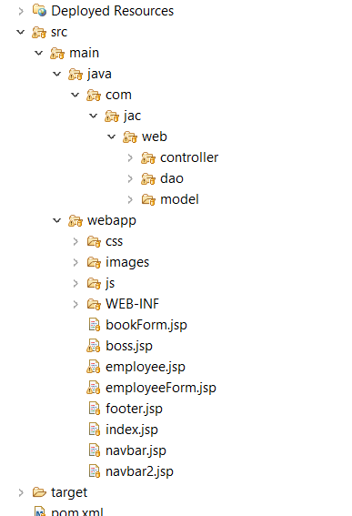
Assets used in the project
Use of GitHub for team collaboration
Database cloud-hosted on GearHost
Using Maven MVC architecture

Slide 3
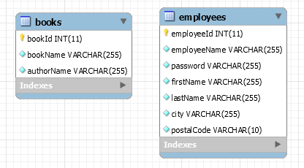
Assets used in the project (contd.)
JDBC API for database connectivity and access
Using Code Conventions: refactoring, indent style, camel-casing, comments
MySQL Database

Slide 4
Problems and Challenges
Resolving GitHub Conflicts
Combining different approaches in one project
Challenges with Eclipse and resolving bugs, errors, like server connection

Slide 5
Lessons learned
Implementing MVC architecture
Login/Logout and user role functionality
User sessions
Implementing a search function
Using includes to keep layout consistent

Slide 6
CRUD operations
Create database & tables
Add MySQL Connector dependency in pom.xml
Create Model and DAO classes
Create Servlet classes & JSP files
Implement web.xml file

Slide 7
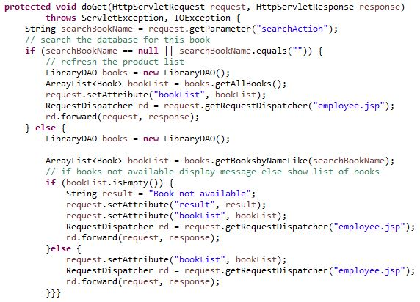
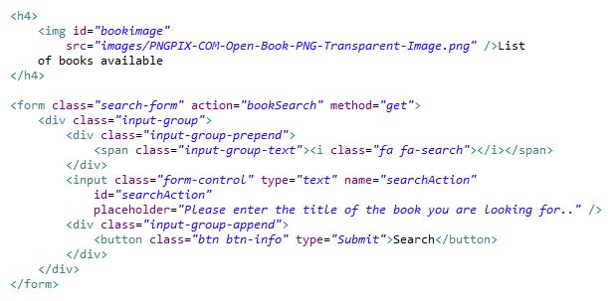
Book Search
BookController.java
employee.jsp

Slide 8
DEMO

